Slide 1
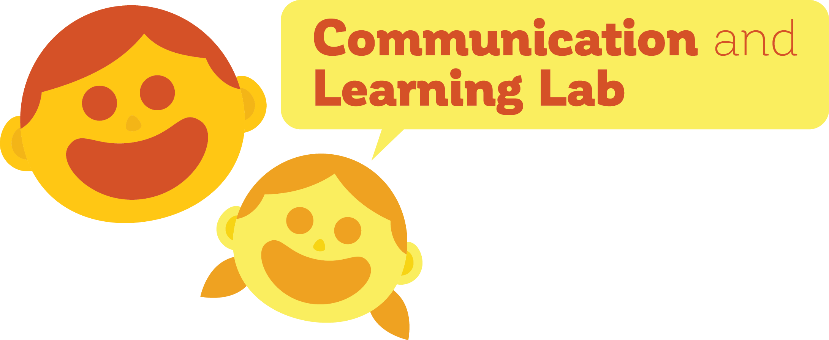
Caregiver reconstruction of children’s errors: the preservation of COMPLEXITY in language
Madeline Meyers
PI: Dan Yurovsky, Ph.D.
University of Chicago

Slide 2
Languages change
Old English (450 – 1150 BCE)
Modern English
heorte
heart
brodor
brother
thou
Brainerd (1989)
Notes:
Also, the extent to which these have been seen as taboos in writing has decreased since the late 18th century, and has decreased now; Language EVOLUTION change over time; may is not really used anymore; prescriptivism doesn’t make any sense teaching, but actually we lose these things; fridge versus refrigerator? Personal computer? Just putting up old English versus now (thou is gone?)

Slide 3
Why do languages evolve?
Languages need to be useful and descriptive
Languages need to be easily learnable by new speakers

Slide 4
These pressures act in everyday interactions
Learnability
This is a bottle
This is a sheep
Baba!
Baba!
Notes:
Sheep & bottle were not learnable for this child; so child makes simplifying errors

Slide 5
These pressures act in everyday interactions
Descriptiveness
???
Want Baba!
Notes:
This causes issues, you need descriptiveness

Slide 6
Children might respond differently to these pressures
Children:
Often simplify words
Have less experience with language
Have different cognitive systems
Speak to different people
Notes:
Lower working memories; also speak to weird people
TOOK OUT PICTURES, MAYBE PUT SOME IN HERE?

Slide 7
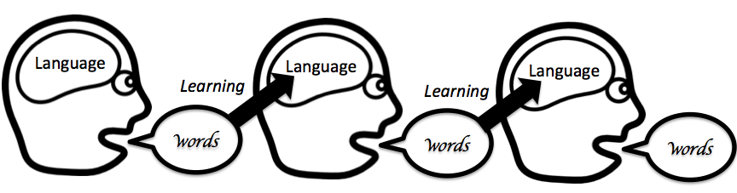
Using iterated learning to study evolution
Resultant language
Randomly-generated language
Generation 1
Generation 2
Generation 3
Kirby et al. (2008)
Notes:
KIRBY PARADIGM

Slide 8
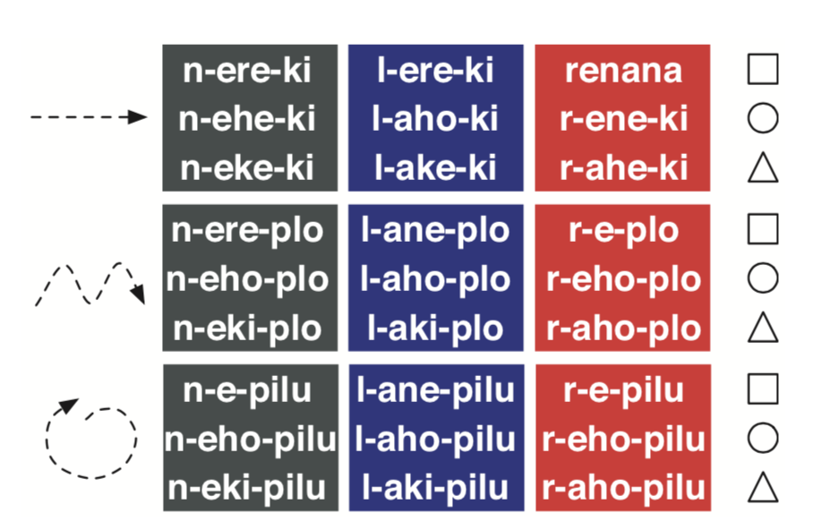
Using iterated learning to study evolution
Kirby et al. (2008)
Notes:
KIRBY PARADIGM

Slide 9
But…
This is not how generational transmission operates
This is a sheep
This is a sheep
This is a sheep
Notes:
This is what prior work has been doing ; add in corrections and talk about dynamic

Slide 10
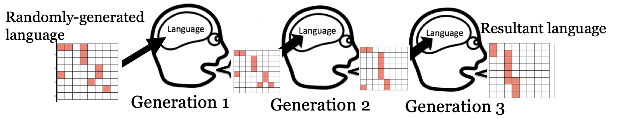
Iterated learning studies with children
Kempe et al. (2015)
Notes:
KEMPE PARADIGM; previous studies with children

Slide 11
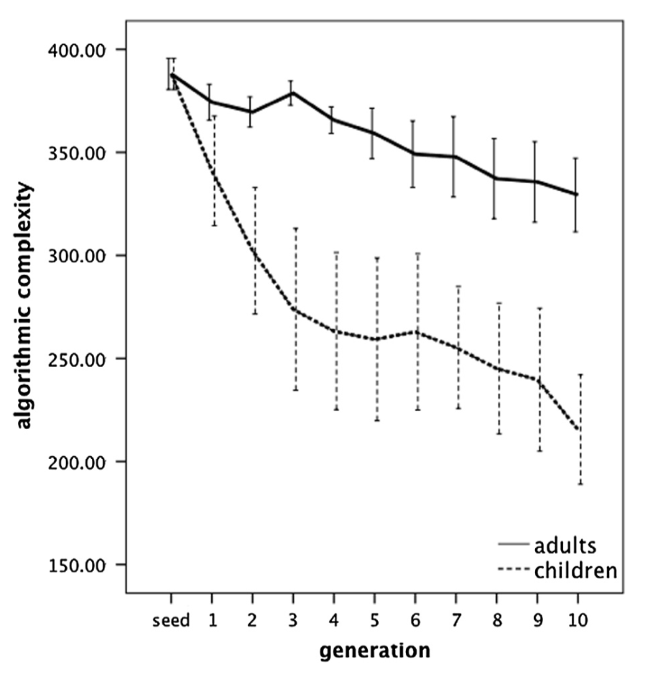
Iterated learning studies with children
Kempe et al. (2015)
Notes:
KEMPE PARADIGM; previous studies with children

Slide 12
This is still not how generational transmission operates
Language is understood based on the listener’s inferences and prior knowledge
Predictions are subject to feedback and correction
This is a sheep
This is a sheep
Baba?
No, sheep
Notes:
This is what prior work has been doing ; add in corrections and talk about dynamic

Slide 13
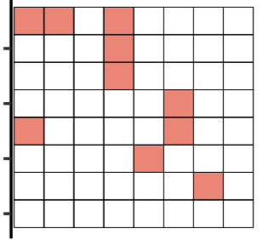
Experiment 1 paradigm
Kempe et al. (2015)

Slide 14
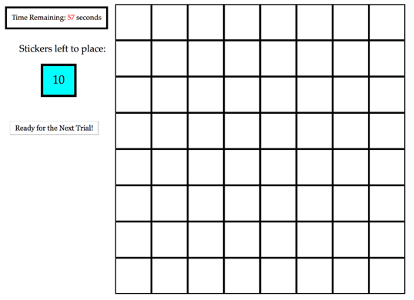
Experiment 1 paradigm

Slide 15
Experiment 1: adult baseline
480 adults on Amazon Mechanical Turk
40 separate chains of 12 generations
Measured
Complexity
Percent Accuracy

Slide 16
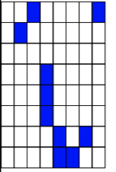
Algorithmic complexity measure
“fill in two cells diagonal in the top, one on the right hand corner, three that are third from the left, make an angular shape and add a diagonal.”
“fill in every other cell”
Zenil et al. (2015)
Notes:
Keep examples but maybe take out text; simpler measures of complexity and compare to other things

Slide 17
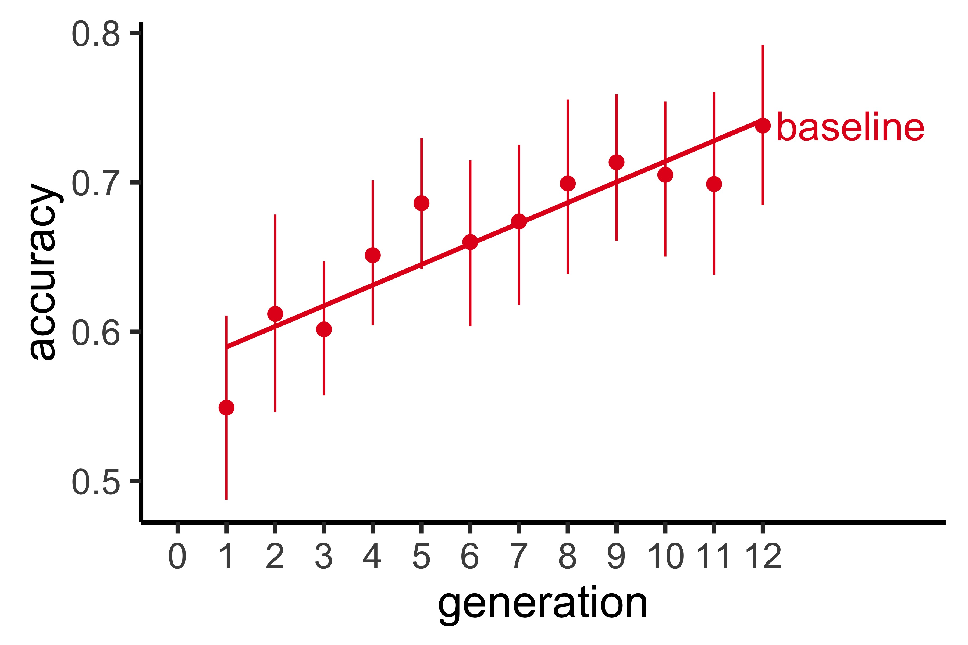
Accuracy increases over generations

Slide 18
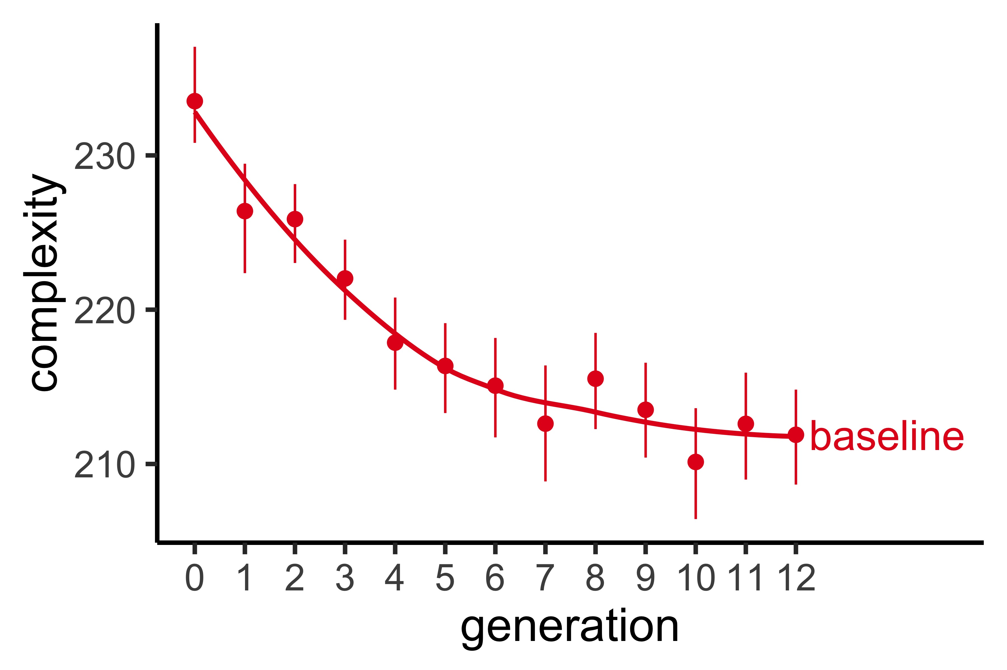
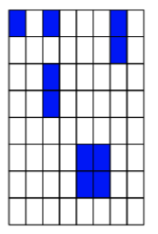
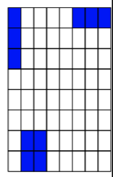
Complexity decreases over generations
Notes:
Put grids directly on this plot
Directly replicates Kempe findings

Slide 19
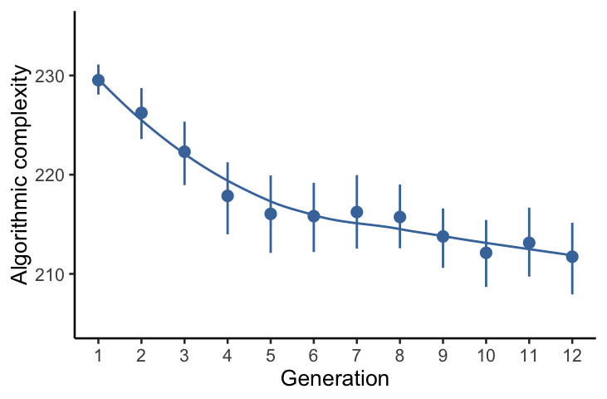
Complexity decreases over generations
Notes:
Put grids directly on this plot
Directly replicates Kempe findings

Slide 20
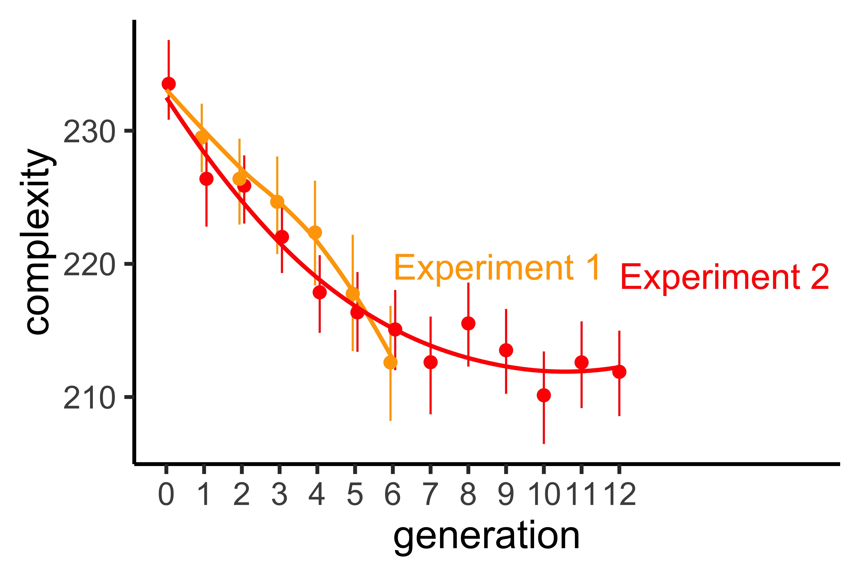
Complexity decreases over generations
Notes:
Put grids directly on this plot
Directly replicates Kempe findings

Slide 21
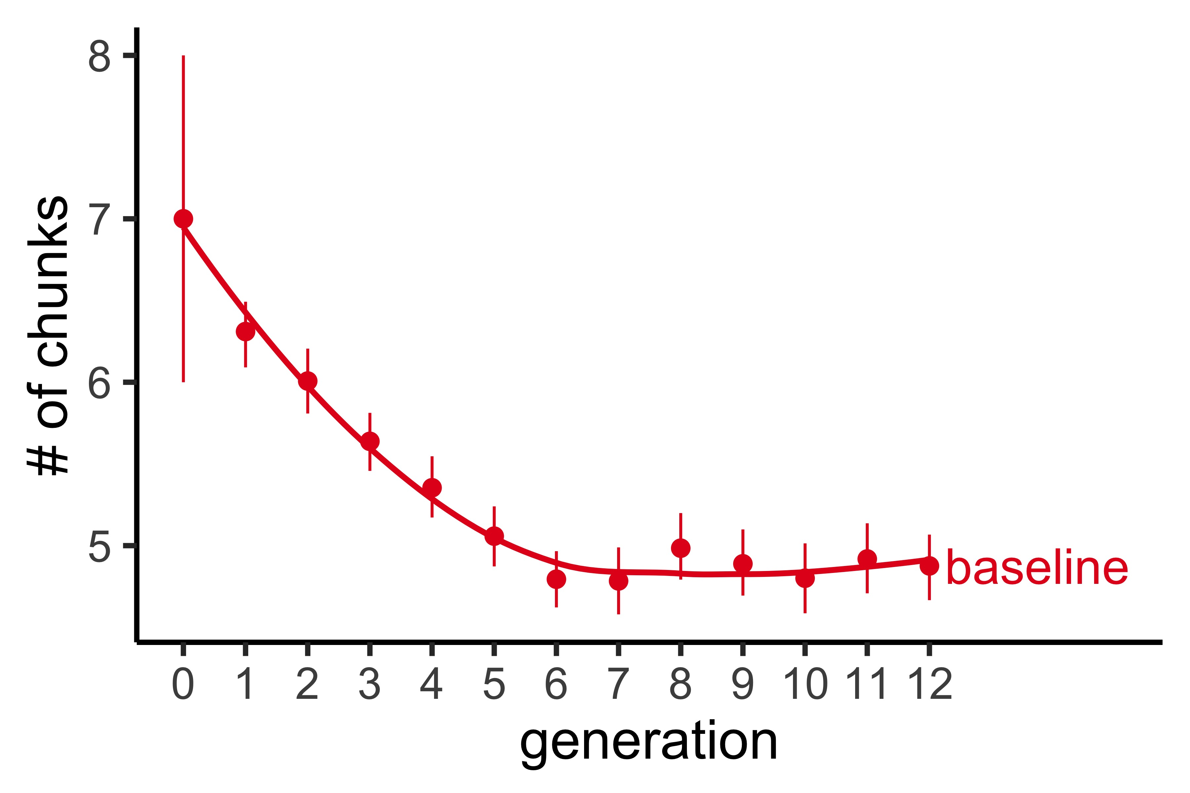
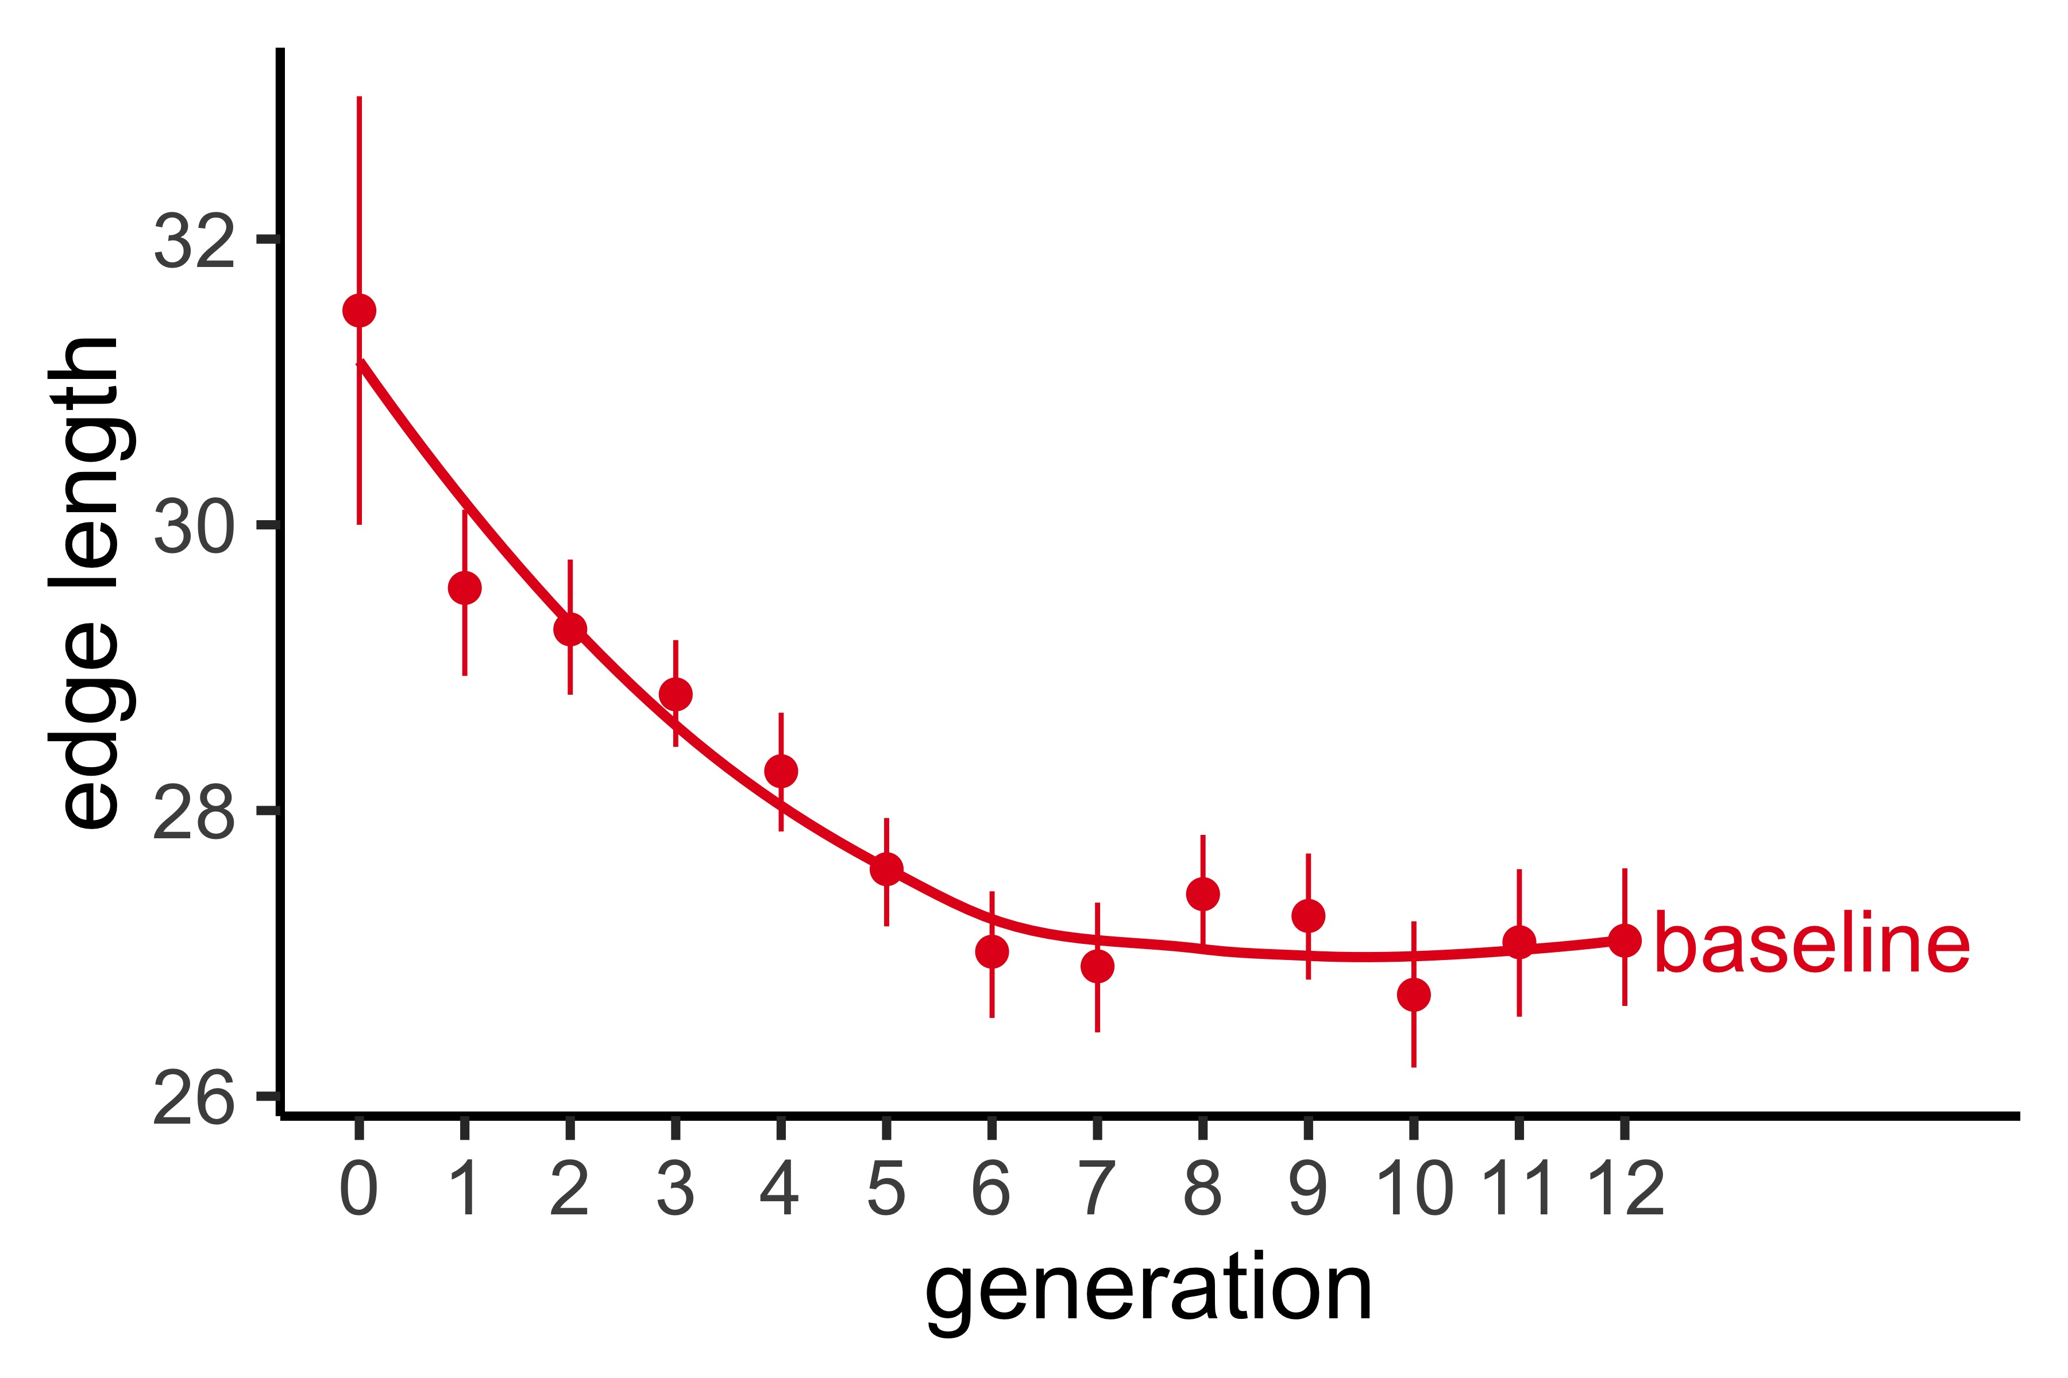
Additional complexity plots

Slide 22
Experiment 2 paradigm
1 ) Learner

Slide 23
Experiment 1 paradigm
1 ) Learner
“your job is to re-create patterns to match a target”

Slide 24
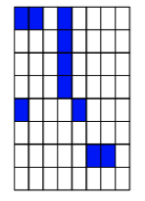
Experiment 1 paradigm
1 ) Learner

Slide 25
Experiment 2 paradigm
2) Fixer

Slide 26
Experiment 1 paradigm
2) Fixer
“your job is to correct errors on the grid patterns to match the target”

Slide 27
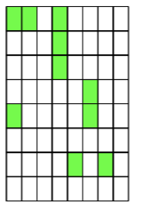
Experiment 1 paradigm
2) Fixer

Slide 28
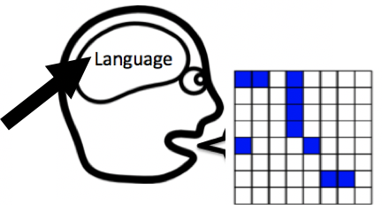
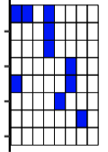
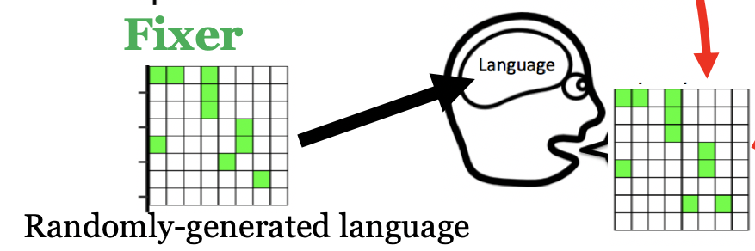
Experiment 2 PARADIGM
1 ) Learner
2) Fixer
“Fix the errors”
Randomly-generated language

Slide 29
Experiment 2: ADULT-ADULT DYAD
960 adults on Amazon Mechanical Turk
480 Learners, 480 Fixers
40 separate chains of 12 generations

Slide 30
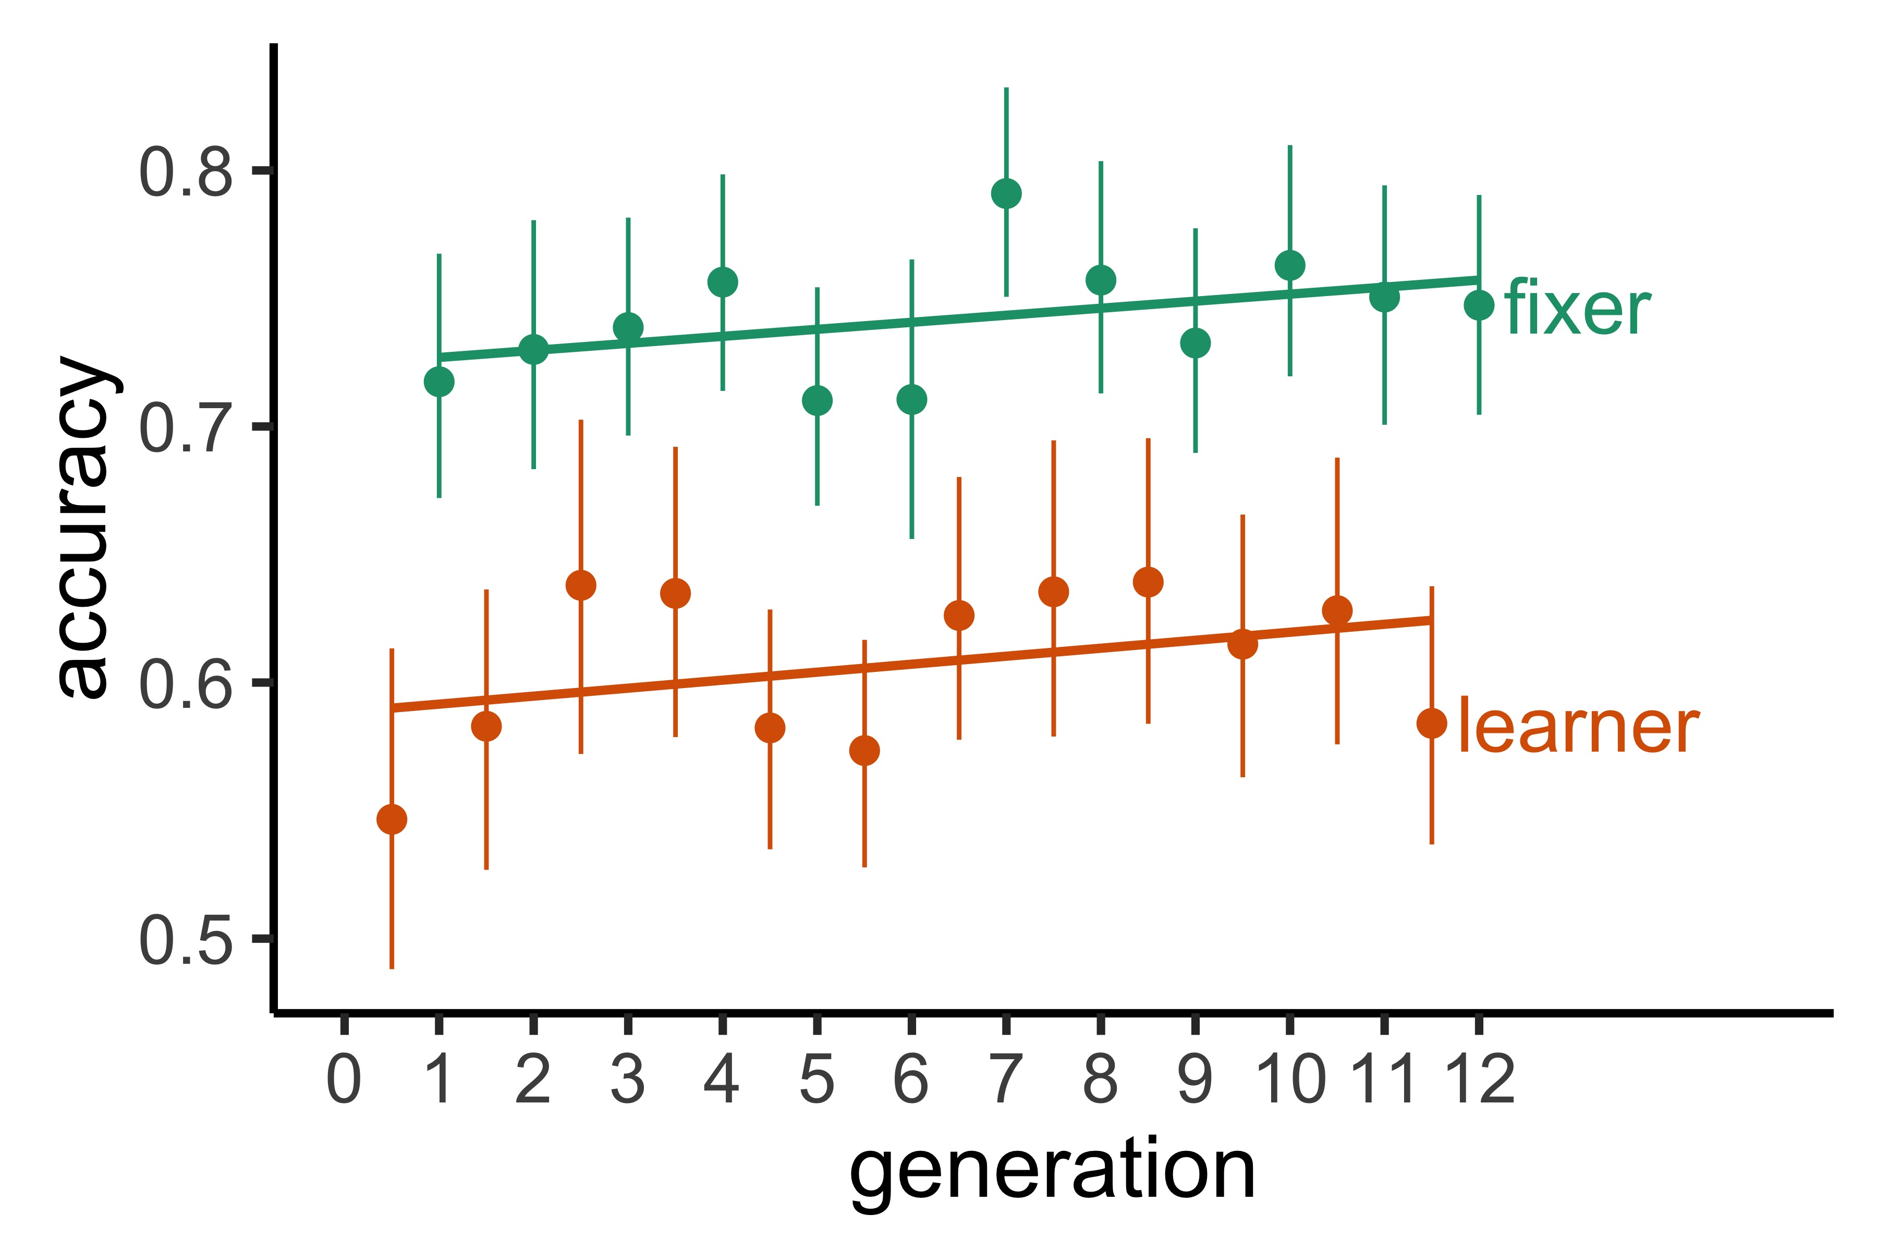
DYAD achieves consistent levels of accuracy

Slide 31
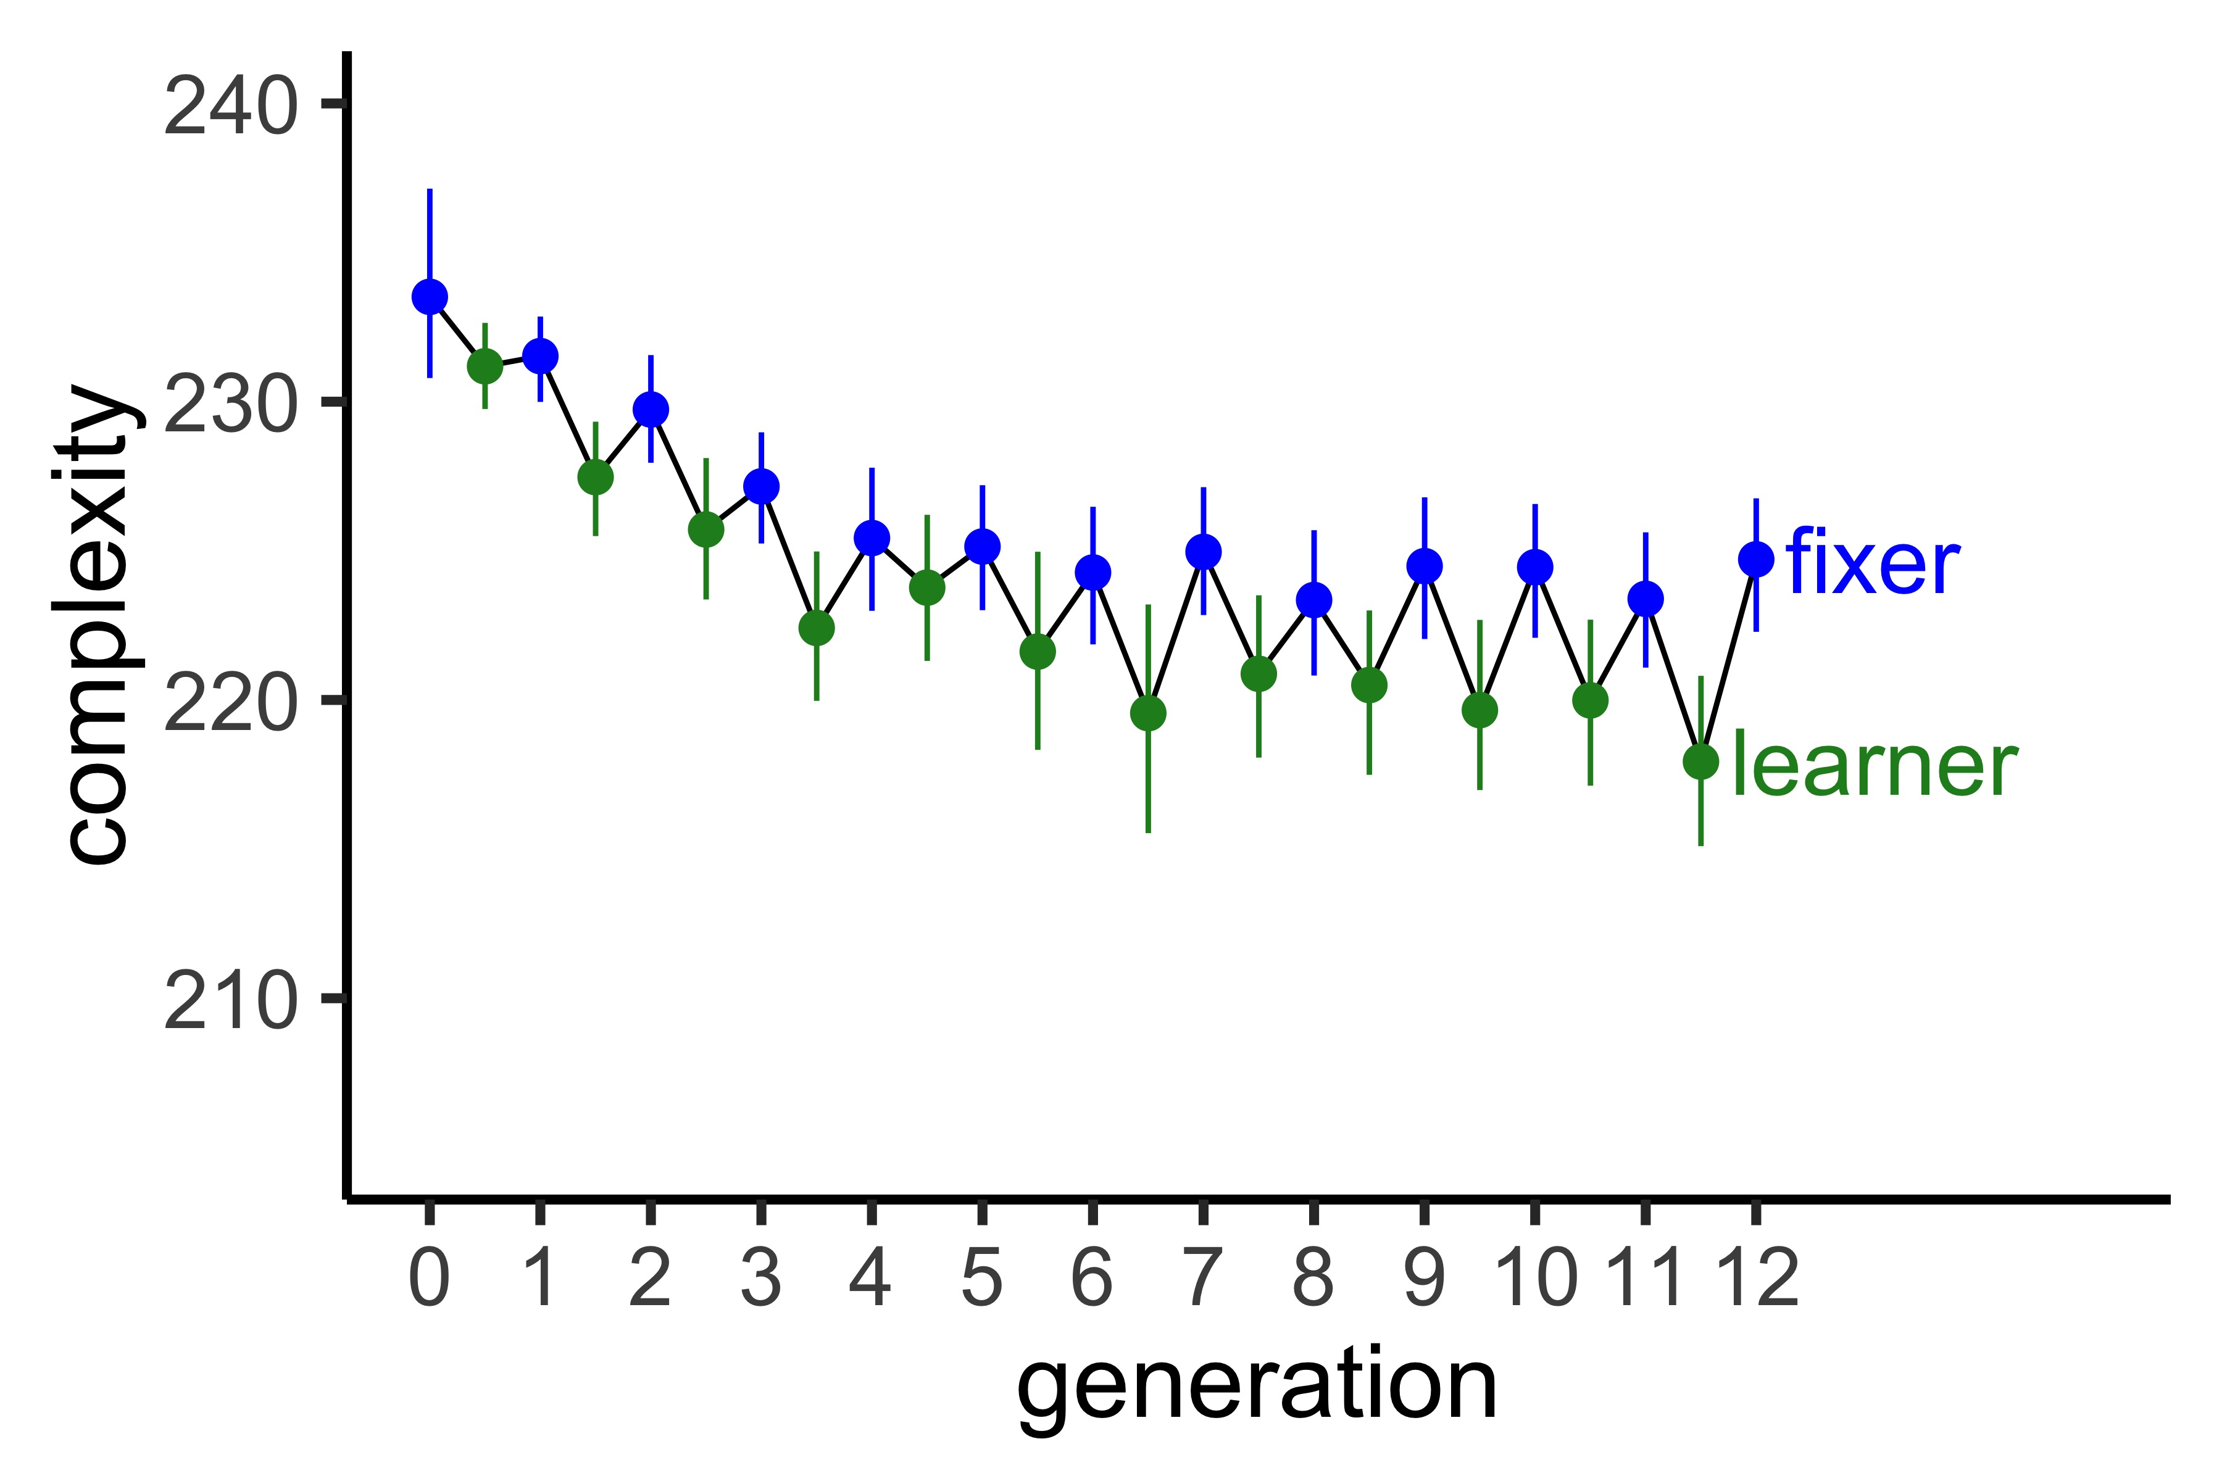
…While Editors Reintroduce complexity
Notes:
Learner is not red change color ; fix axes ; think about how to talk about passing on fixer’s language

Slide 32
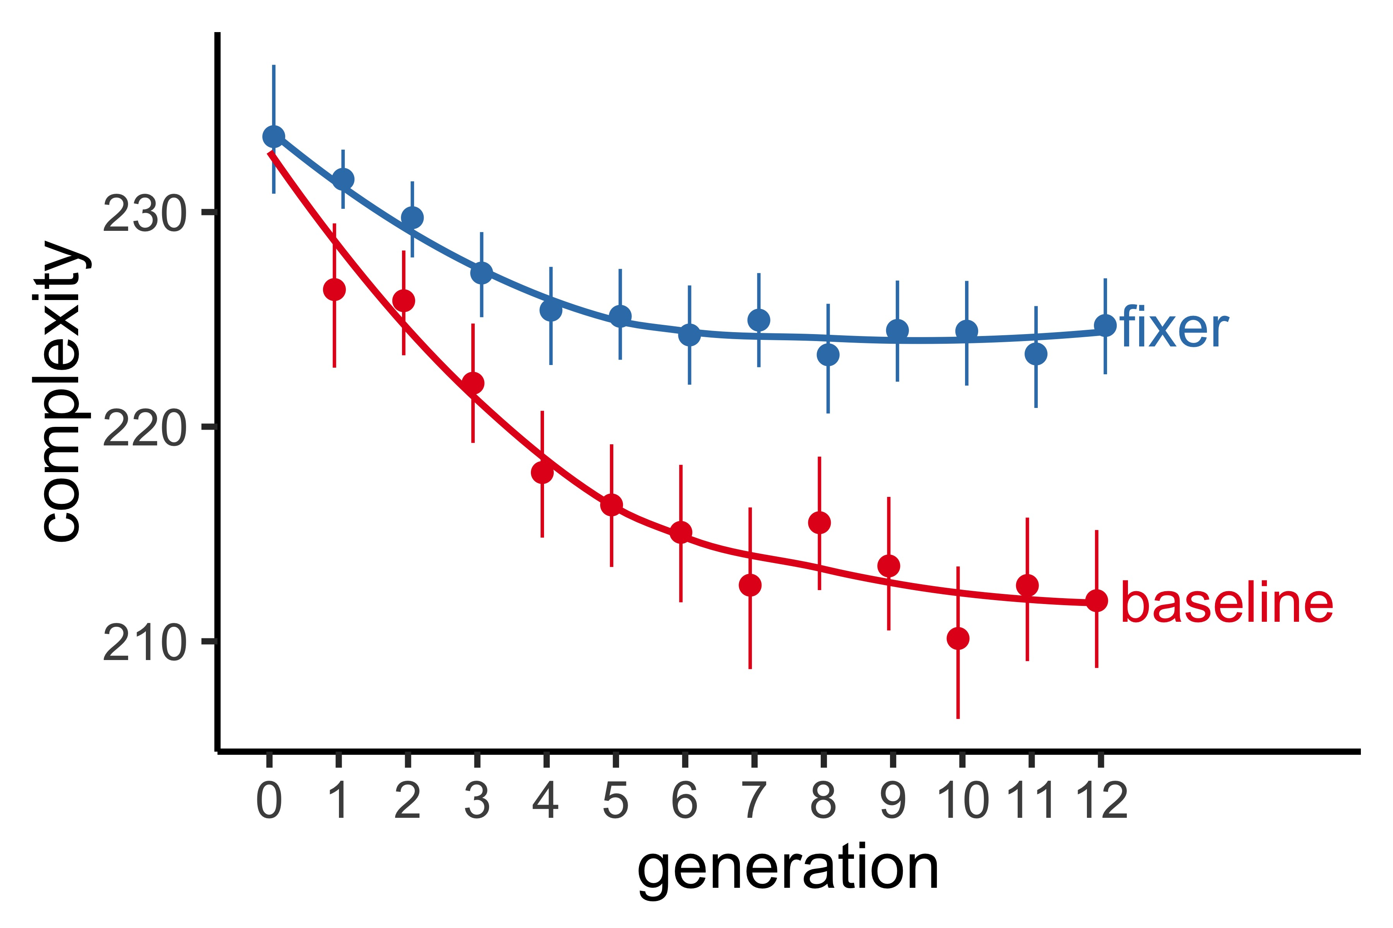
Editors help retain a higher level of complexity
Notes:
Feedback on how to describe the fixer passing on language

Slide 33
Preliminary conclusions
These languages seem to be reaching a stable level of complexity
Balance between descriptiveness and simplicity/learnability
The presence of an editor helps retain more complexity than an individual learner alone
Reduces memory load
This paradigm can be used to answer questions about the effects of transmissibility pressures

Slide 34
Ongoing work
Collecting data in Experiment 1 and 2 (baseline & dyad) conditions with children ages 6-8 at the Museum of Science and Industry
Children are “learners” and adults (online) are “fixers”
~60 / 240 data points collected so far
Notes:
Data collected from 60 kids so far

Slide 35
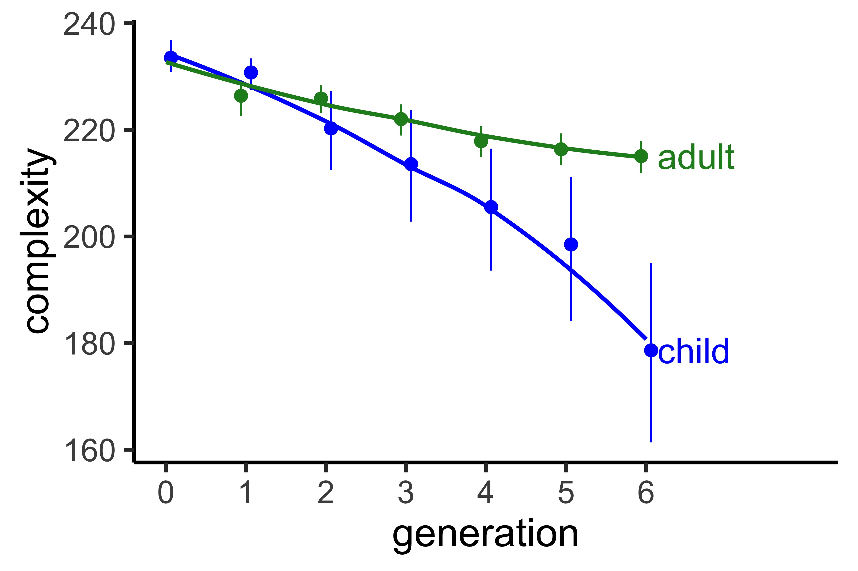
Preliminary child baseline results
Notes:
Data collected from 60 kids so far

Slide 36
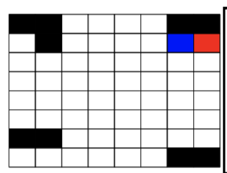
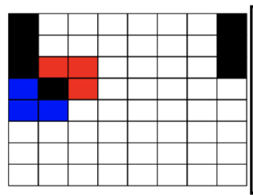
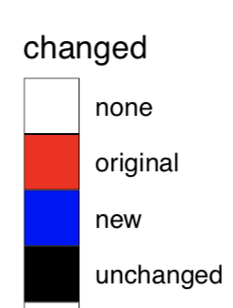
Qualitative Analysis
Are children just making more errors, or are they making different errors
Develop coding scheme to identify these differences
Notes:
Ideas/feedback about this? How to create coding scheme and what these differences would tell us

Slide 37
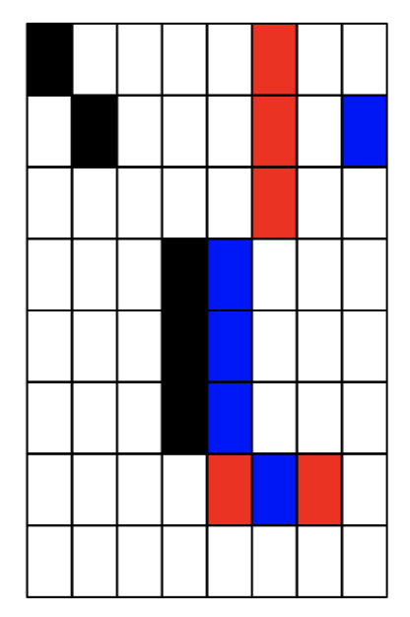
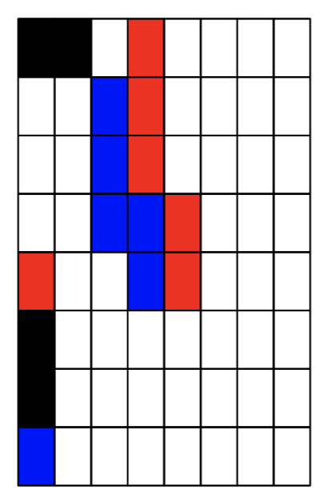
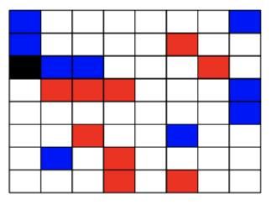
Qualitative Analysis
Notes:
Ideas/feedback about this? How to create coding scheme and what these differences would tell us

Slide 38
Qualitative Analysis
Notes:
Ideas/feedback about this? How to create coding scheme and what these differences would tell us

Slide 39
Structure task
Compare grids from different trials within a chain to see if structure is emerging across the “language” as a whole
Turk similarity task
Notes:
Ideas/feedback about this? How to create coding scheme and what these differences would tell us

Slide 40
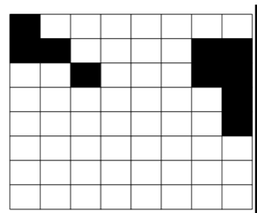
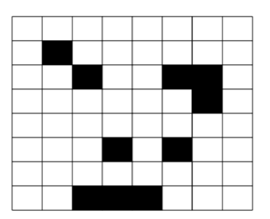
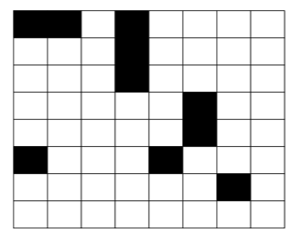
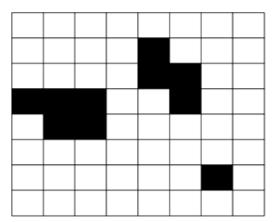
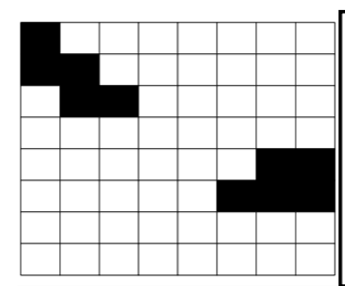
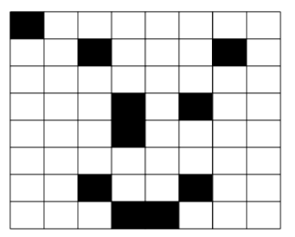
Structure task
Chain 2, Trial 2, Generation 6
Chain 2, Trial 2, Generation 2
Chain 1, Trial 1, Generation 1
Chain 1, Trial 1, Generation 5
Chain 1, Trial 2, Generation 2
Chain 1, Trial 2, Generation 6
Notes:
Ideas/feedback about this? How to create coding scheme and what these differences would tell us

Slide 41

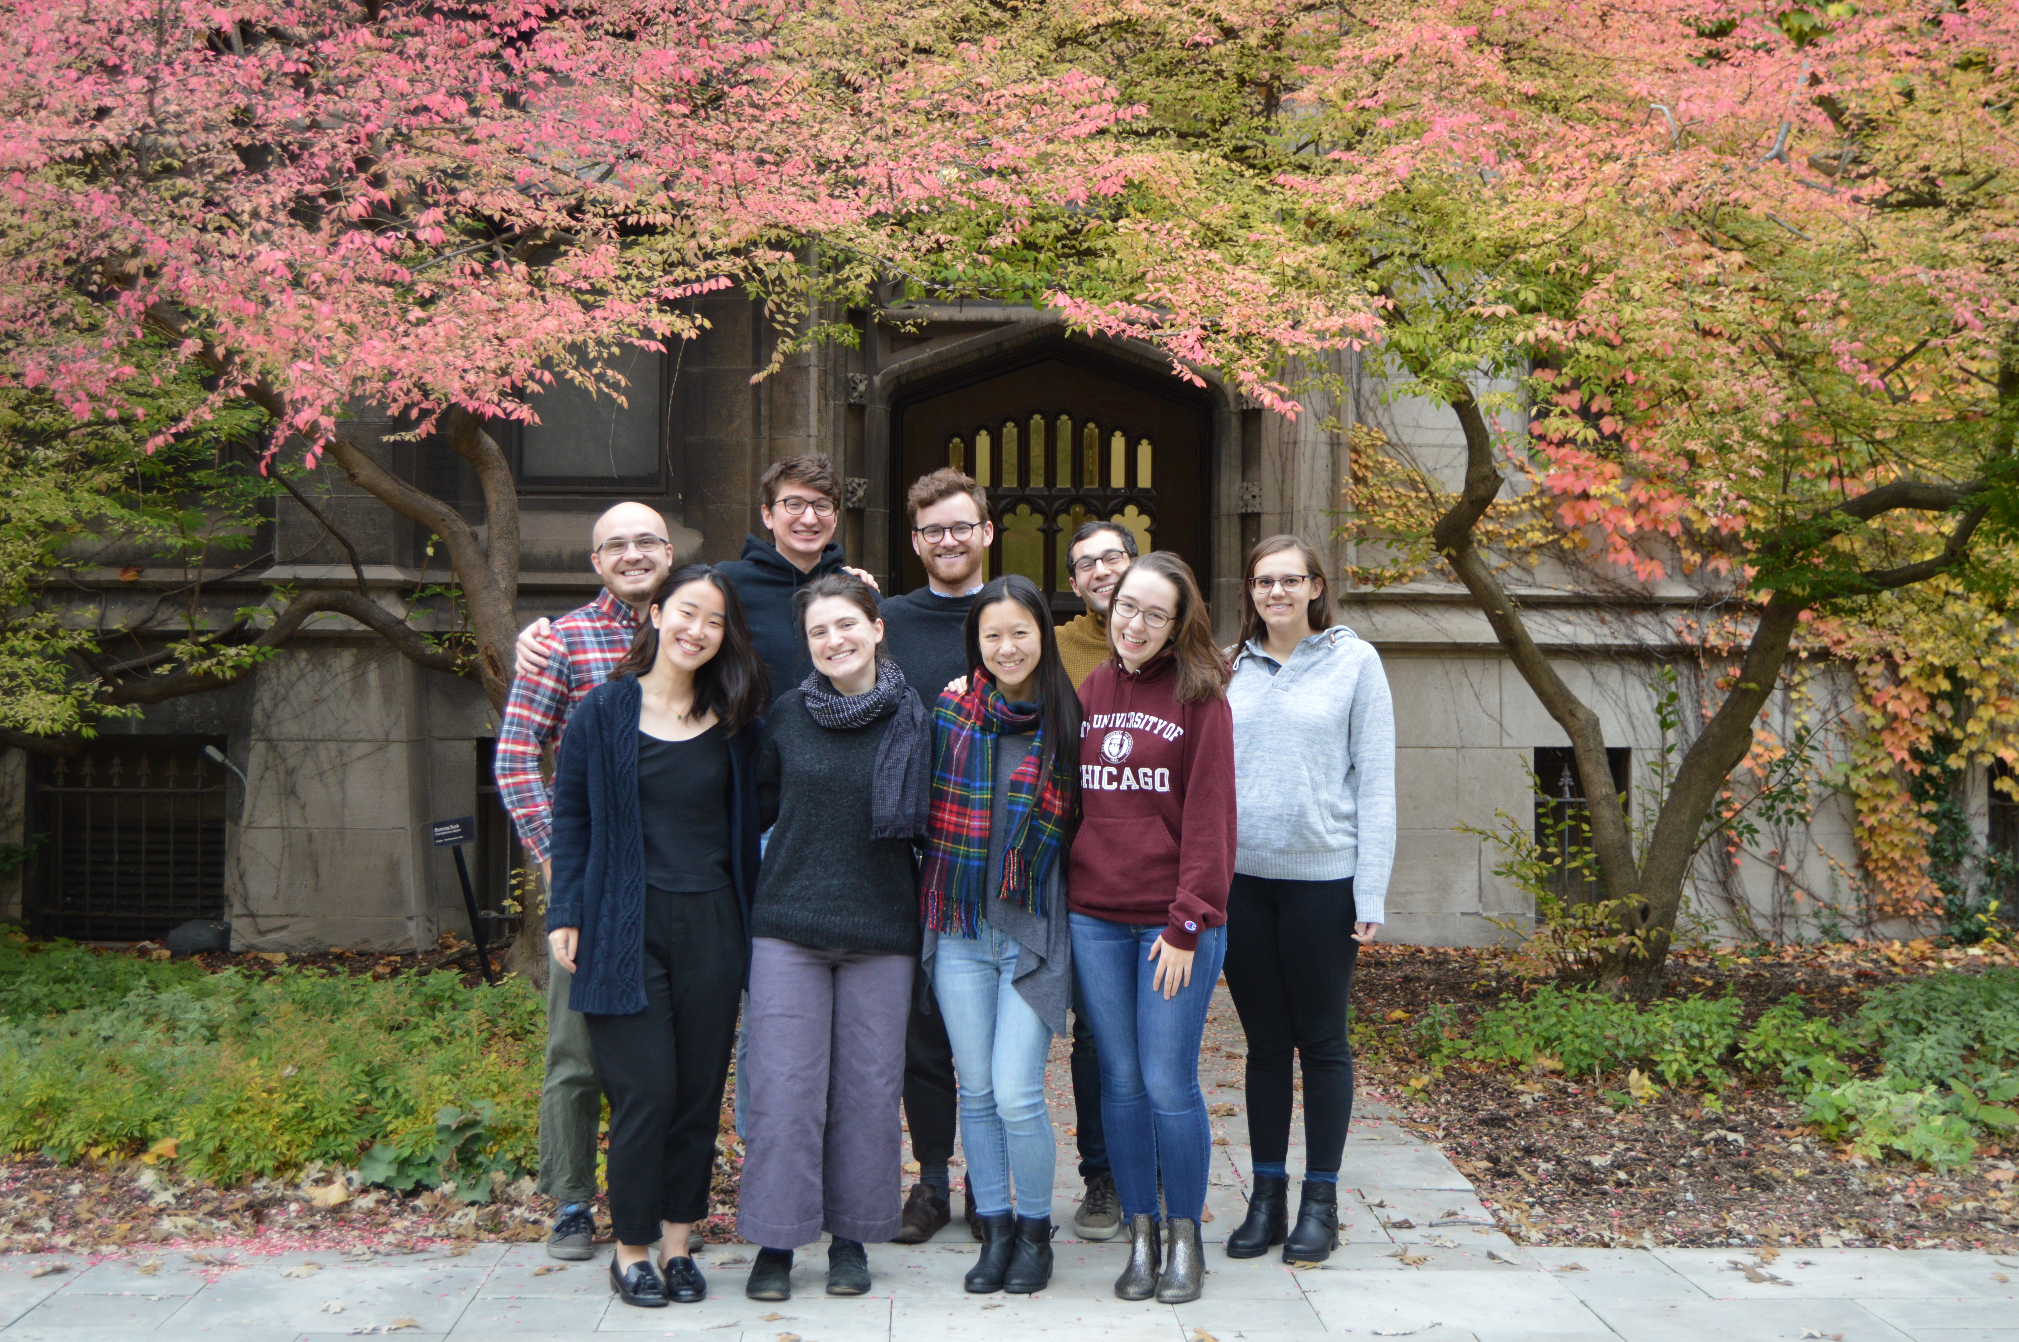


Thank you!

Slide 42
Algorithmic complexity measure ctd.
Kolmogorov-Chaitin Complexity (based on Coding Theorem Method)
Length of shortest program that outputs a string to describe pattern on a Universal Turing machine
Calculate for 4x4 patterns
Zenil et al. (2015)
Notes:
Keep examples but maybe take out text; simpler measures of complexity and compare to other things

Slide 43
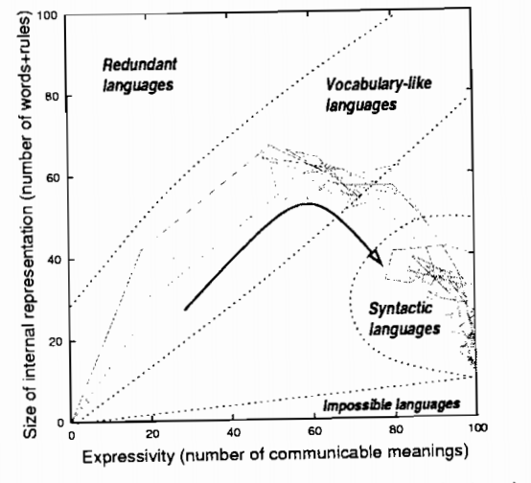
Languages show the effects of these pressures
Kirby, S., & Hurford, J. R. (2002).

Slide 44
Descriptiveness pressure
Pushes language towards complexity
Can you hand me the spoon?
Which one?
Oh, the ladle
Notes:
Pressure to have referential efficiency reduce ambiguity with ladle, spork, things that are spoon like, siv, teaspoon ; but we call these things what which reflects a cost ; have corrective elements within the examples ; nicknames versus child saying baba for bottle ; maybe have one where child production is accepted and not accepted?

Slide 45
Transmissibility pressure
Pushes language towards simplicity
This is a spoonandiferadoja
You mean a spoon?
Notes:
Bottle ; what did they say ; simplicity on form and complexity on meaning ; people wont make jump that if you need a word for everything you need longer words ; assuming that people get that the thing is for more specifc; ground this example in real worlds

Slide 46
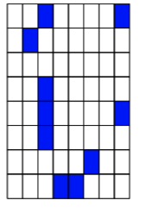
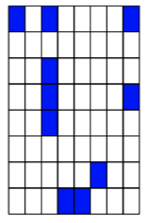
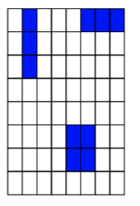
Experiment 1 results
Initial
Generation1
Generation 2
Generation 4
Complexity: 231
Complexity: 235
Complexity: 243
Complexity: 211
Generation 5
Generation 9
Generation 12
Complexity: 229
Complexity:
Complexity:

Slide 48
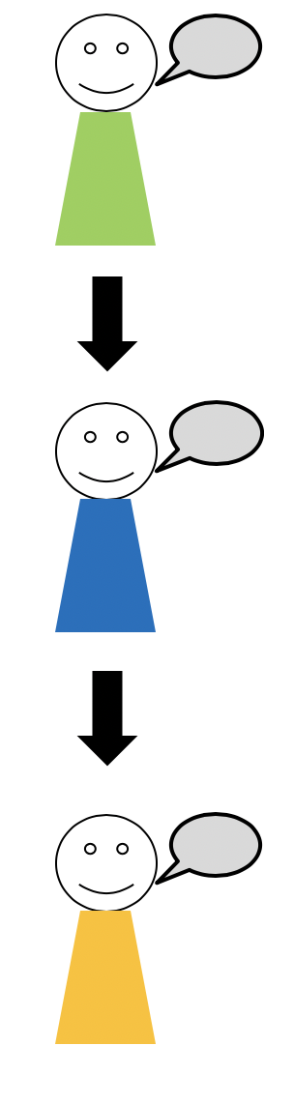
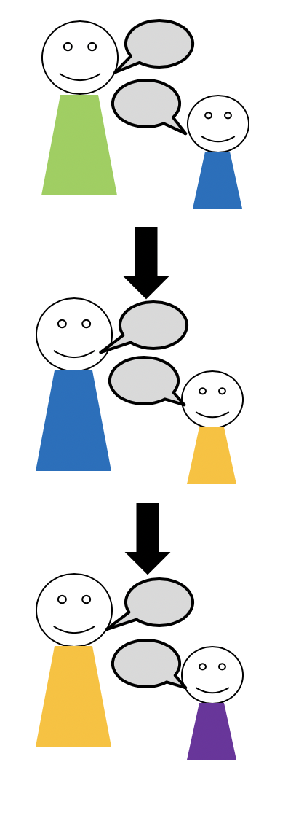
Experiments 1 & 2
Experiment 3

Slide 49
